Slide 1
DocoGPT
Final Presentation
Hongda Lin, Xukun Liu, Yibo Chen

Slide 2
Presentation Outline
Introduction
Expected Outputs
Design Diagrams & Explain
Demo
Technical Risks
Remaining Problems

Slide 3
Introduction
What is DocoGPT?
DocoGPT is a platform that can understand and analyze user-uploaded documents, such as research papers, and answer questions related to the document content.

Slide 4
2. Expected Outputs
In general, DocoGPT could complete the tasks including document summarization and Q&As.
DocoGPT is aimed to achieve higher accuracy in finding answers related to user’s question in the vector database by employing a hierarchical information architecture.

Slide 5
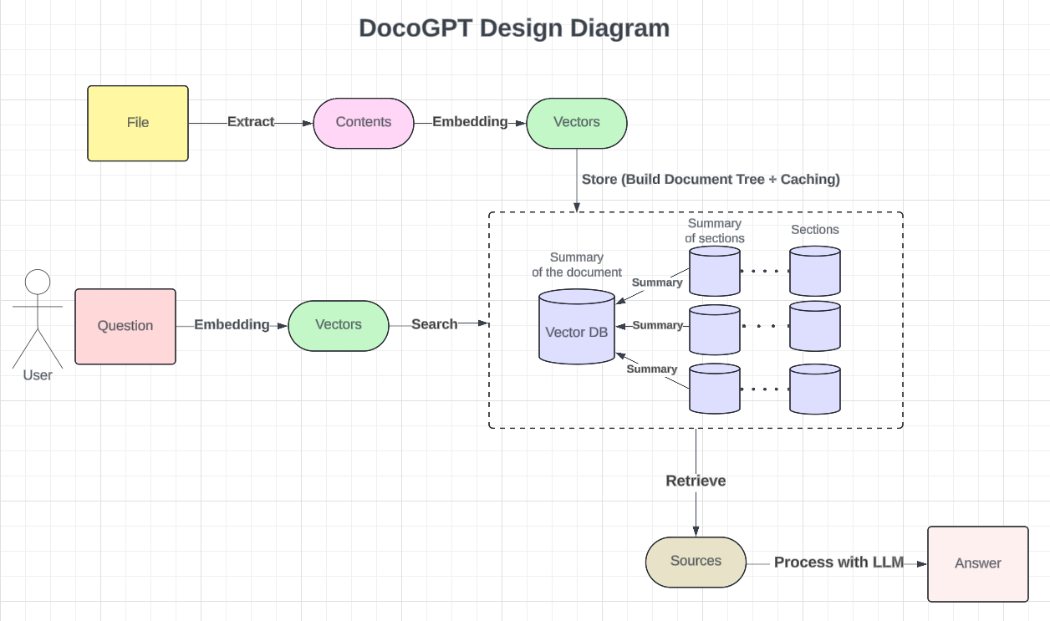
3. Design Diagram
Link

Slide 6
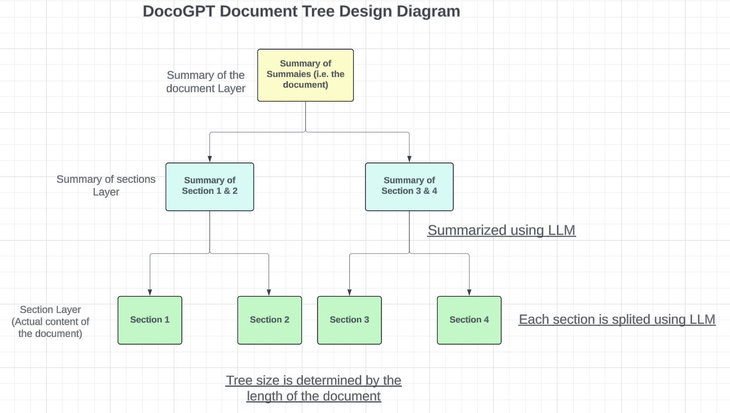
4. Document Tree Design Diagram
Link

Slide 7
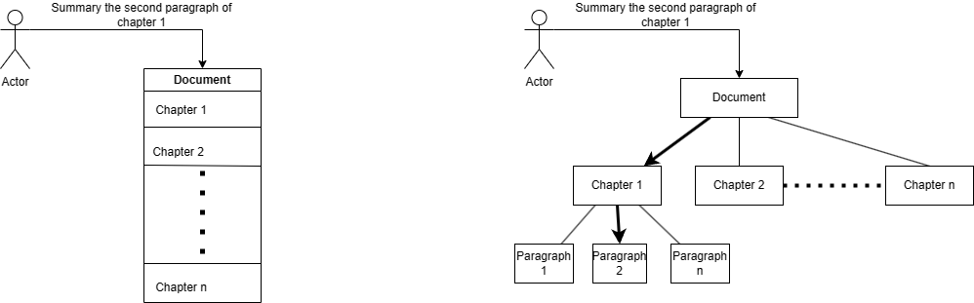
5. How DocoGPT achieve high accuracy?
Instead of embedding the document content as a whole, DocoGPT employs a hierarchical information architecture to break down document content into different layers.
How many baselines were used in Experiment Chapter
How many baselines were used in Experiment Chapter
Notes:
Structure:
Root Layer (L0): Summarizes the entire document.
Chapter Layer (L1): Provides summaries for each chapter.
More Layers (LN): Optional
Implementation:
Uses a combination of extractive and abstractive summarization, supported by deep NLP models to ensure precise information retrieval.

Slide 8
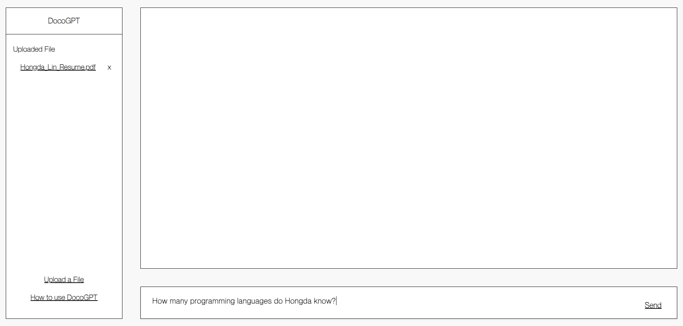
6. How to use DocoGPT?
You can ask document-related questions like:
How should I use XYZ?
Or ask general questions such as:
What is the purpose of this document?
Step 1: Upload a file (pdf version)
Step 2: Ask a question related to the file

Slide 9
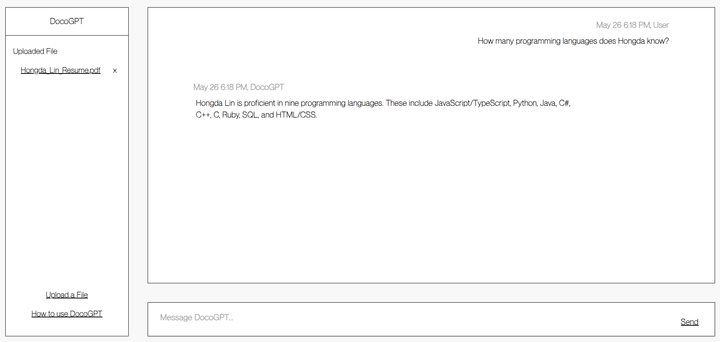
6. How to use DocoGPT?
Step 3: Ask a question related to the file
Step 4: Receive response from DocoGPT
Step 3: Click Send

Slide 10
Demo

Slide 11
7. Technical Risks
Accuracy
Challenge: Inaccurate Node Retrieval. Inaccuracy in retrieving the correct node impacts the efficiency and effectiveness of our content delivery system.
Solution: Upgrade to GPT-4 and Prompt Optimization
Performance
Challenge: Efficiency Impacted by Number of Children. Determining the optimal number of children for each node influences the node selection, which in turn affects the efficiency of traversals.
Solution: Optimal Tree Model Selection

Slide 12
8. Remaining Problems
Challenge: Increased Complexity and Size of Document Content
Time-consuming tree construction
High token consumption
Slower traversal times

Slide 13
Thank you!
Any questions?

